Slide 1

Real Time Ecommerce Data Analysis
BTech CS-AI Fifth Semester
Vishal S BL.EN.U4AIE20074
Varun K BL.EN.U4AIE20071
Monish Mohanty BL.EN.U4AIE20033
21AIE204
~ Mr. Saravanan S

Slide 2
Abstract
Real-time e-commerce data analysis refers to the process of collecting, analyzing, and interpreting data from an e-commerce platform in real-time.
This can include data on customer behaviour, sales, and product performance. The goal of real-time e-commerce data analysis is to provide businesses with up-to-date insights that can inform decision-making and help them to improve the customer experience, increase sales, and optimize operations.
This can be achieved through using various technologies such as Data Warehousing, data mining, real-time streaming analytics and predictive modelling.
Real-time e-commerce data analysis is a powerful tool that can provide businesses with valuable insights and help them to improve customer experience, increase sales, and optimize operations.

Slide 3
Introduction
Our project aims to provide a Real-time e-commerce data analysis is the process of continuously collecting, analyzing, and interpreting data from an e-commerce platform in real-time, it provides a beneficial insight and analysis capabilities.
Our work allows to make the all the data in the market more accessible and understandable to a wide range of users and to provide an easy way to monitor the market and make informed decisions.
E-commerce platforms generate a vast amount of data, including customer behaviour, sales, and product performance, and real-time e-commerce data analysis provides a way to make sense of this data and turn it into actionable insights.
With real-time data analysis, businesses can quickly identify trends, patterns, and customer preferences, which can help them to adapt their strategies and make data-driven decisions.

Slide 4
Literature Review
“Rustagi, A. (2012). A Near Real-Time Personalization for eCommerce Platform. In: Castellanos, M., Dayal, U., Lehner, W. (eds) Enabling Real-Time Business Intelligence. BIRTE 2017. Lecture Notes in Business Information Processing, vol 126. Springer, Berlin, Heidelberg. ”
A literature survey on real-time e-commerce data analysis would reveal a growing body of research in this area.
One area of research focuses on using real-time data analysis to improve the customer experience. For example, some studies have investigated using real-time data on customer behavior to personalize product recommendations, website layouts, and marketing campaigns.
Other research has looked at using real-time customer feedback to improve customer service.

Slide 5
Literature Review
II. “Department of Information Technology, VFSTR Deemed to be University, Vadlamudi Village, Guntur District, Andhra Pradesh 522213, India 2 Department of Management Studies, VFSTR Deemed to be University, Vadlamudi Village, Guntur District, Andhra Pradesh 522213, India”
Another area of research focuses on using real-time data analysis to optimize business operations.
For example, some studies have investigated using real-time inventory data to optimize the reorder point and replenishment of products.
Other research has looked at using real-time data on sales and customer behaviour to optimize pricing strategies.
Predictive modelling is another area of research when it comes to e-commerce data analysis, it can help in forecasting demand, revenue and customer behavior.

Slide 6
Software Requirements
Dataset
Python – version 3.10
Kafka - version 2.13
Apache Spark – version 3.3.1
MongoDB – version 5.0
Streamlit

Slide 7
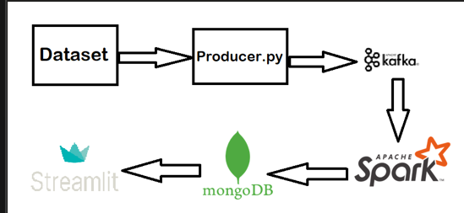
Data Pipeline

Slide 8
Methodology
Data Collection
Dataset
The data is retail relevant, it has columns such as category of product, city of the customer. The data is streamed by a producer to kafka row by row.
Producer.py
The data is collected using a Python script that makes processes the dataset row by row and pushes it to the kafka topic. The script can be designed to run periodically or continuously to gather new data as it becomes available. Once the data is collected, it is pushed to a Kafka topic. Kafka is an open-source distributed event streaming platform that is used to handle the real-time streaming of data. By pushing the collected data to a Kafka topic, it can be easily consumed by other components of the system for further processing and storage

Slide 9
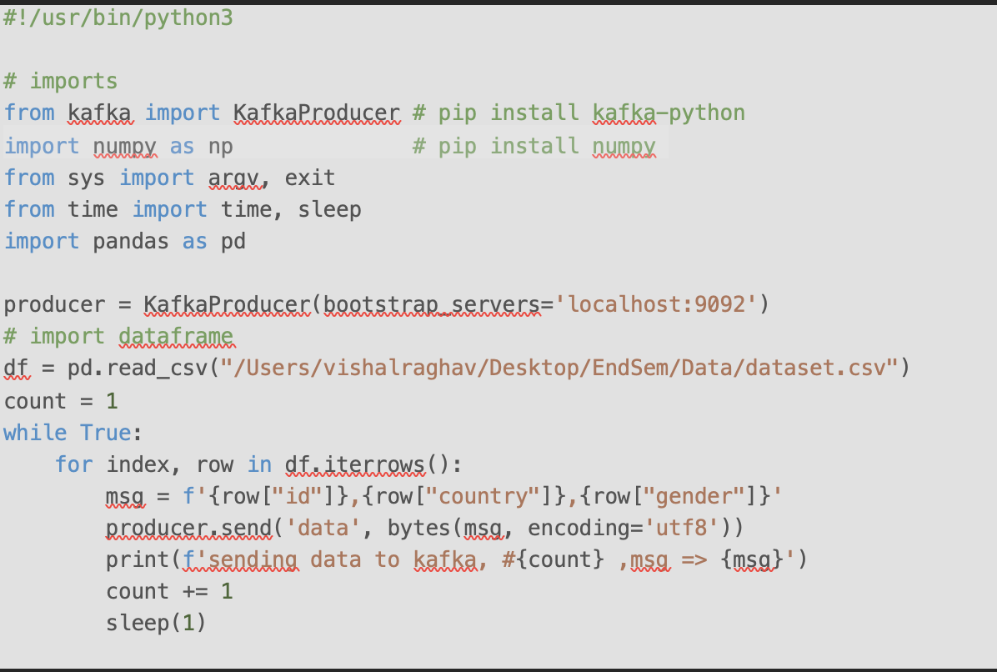
Producer.py

Slide 10
Methodology
Data Processing
A. Kafka
The collected stock data is pushed to a Kafka topic for real-time streaming. Kafka acts as a buffer to handle any differences in data collection rate and data processing rate, it allows data to be processed as soon as it is collected. Kafka is also used to handle the real-time streaming of data from the data collection component to the data processing and storage components of the system.
B. Spark
Once the data is in the Kafka topic, it can be consumed by Spark for further processing and transformation. Spark is a distributed computing framework that is designed for big data processing, and it can handle large dataset and real-time streaming. Spark can be used to perform any necessary data analysis and transformation, it allows to perform data cleaning, filtering and aggregation tasks on the data.
C. MongoDB
The processed data is then stored in MongoDB, a NoSQL database which is optimized for data that is unstructured or semi-structured, it allows for querying and searching easily. MongoDB stores the data in a flexible, scalable and high-performance way, it can handle large amount of data, it's also easy to scale horizontally by adding more nodes to the cluster.

Slide 11
Methodology
Data Visualization
Data visualization is the final step in the process of collecting, processing, and visualizing data. The data visualization component of the system involves using streamlit, a Python library for creating interactive apps, to read the data from MongoDB and display it in a real-time line plot.
Streamlit
Streamlit is a powerful library that allows you to easily create interactive visualizations and plots without the need for JavaScript. It supports a wide range of UI elements and chart types, including line plots, bar charts, scatter plots, and more. The library can be used to create visualizations that can be rendered in a web browser, making them easily accessible to users.
In this case, the system uses Streamlit to read thedata from Kafka, which is used to create a line plot that shows the real-time changes.

Slide 12
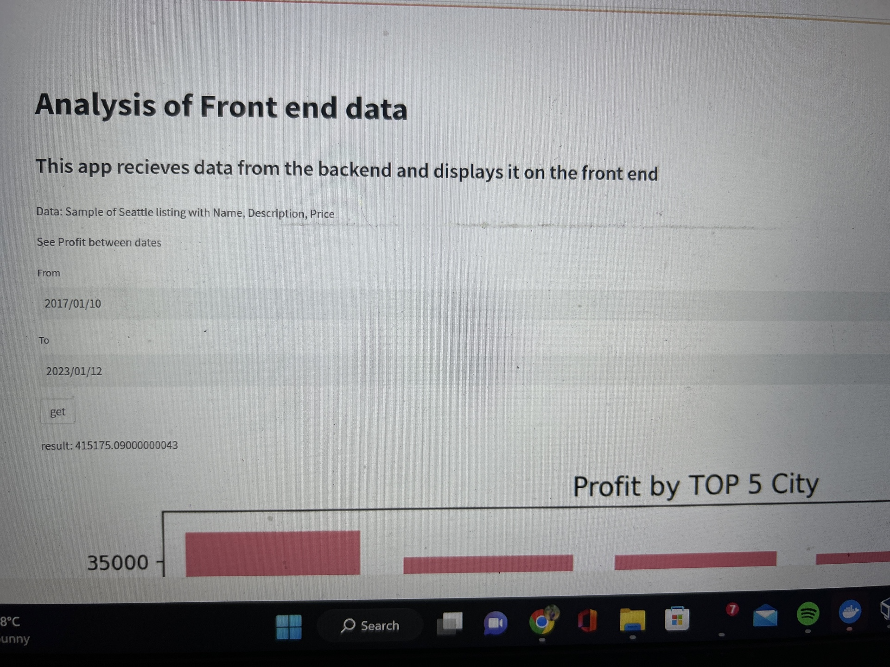
RESULTS

Slide 13
Demonstration

Slide 14
Conclusion
Our project is a comprehensive system for a Real time Ecommerce Data Analysis .
It is designed to provide users with a comprehensive and interactive way to monitor sales prices and trends in real-time.
The system consists of three main components: data collection, data processing, and data visualization. The data collection component uses the dataset to stream data. The data processing component uses Kafka and Spark to process the data and store it in MongoDB, this allows for flexible and scalable data storage.
The data visualization component uses Streamlit, a Python library for creating UIs and visualizations, to read the data from MongoDB and display it in a real-time line plot.

Slide 15
Future Work
There are several areas where the project could be improved or expanded upon in the future:
Additional data sources: An API to provide data instead of a dataset. An API will provide realitime data and hence will be more accurate.
Advanced analytics: Additional analytics tools, machine learning models and statistical techniques could be used to analyze the data and provide more insights,
Real-time alerts and machine learning: We can use machine learning algorithms to analyse trends and visualize outputs. This will benefit retail owners

Slide 16
References
https://spark.apache.org/docs/latest/structured-streaming-kafka-integration.html
https://spark.apache.org/docs/latest/structured-streaming-programming-guide.html#types-of-time-windows
https://www.mongodb.com/developer/languages/python/streaming-data-apache-spark-mongodb/
Agarwal, R., & Dhar, V. (2014). Editorial—big data, data science, and analytics;https://link.springer.com/article/10.1007/s12525-016-0219-0
Rustagi, A. (2012). A Near Real-Time Personalization for eCommerce Platform. In: Castellanos, M., Dayal, U., Lehner, W. (eds) Enabling Real-Time Business Intelligence. BIRTE 2011. Lecture Notes in Business Information Processing, vol 126. Springer, Berlin, Heidelberg. https://doi.org/10.1007/978-3-642-33500-6_8
Department of Information Technology, VFSTR Deemed to be University, Vadlamudi Village, Guntur District, Andhra Pradesh 522213, India 2 Department of Management Studies, VFSTR Deemed to be University, Vadlamudi Village, Guntur District, Andhra Pradesh 522213, India
https://d1wqtxts1xzle7.cloudfront.net/63795833/62.2-4_0420200701-82660-bhlpdr-libre.pdf?1593594706=&response-content-disposition=inline%3B+filename%3DWeighted_Based_Frequent_and_Infrequent_P.pdf&Expires=1673494417&Signature=MMeXKic1NFKO8xIhRa7ZwuPiZ-HlEzs

Slide 17
THANK YOU

